Slide 1

Word 2007 Basics
For new or beginning users of Word 2007.
This workshop will cover valuable features including finding common commands, understanding the open XML file formatting, reviewing documents, using the Document Inspector, and working with SmartArt.
Janiess Sallee| Assistant Director of Instructional Technology Services | Seattle Pacific University | jsallee@spu.edu

Slide 2
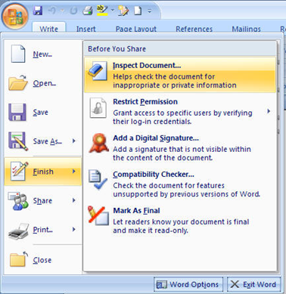

Quick Tour
Office Button
Tabs
Ribbons
Groups
Commands
Quick Access

Slide 3
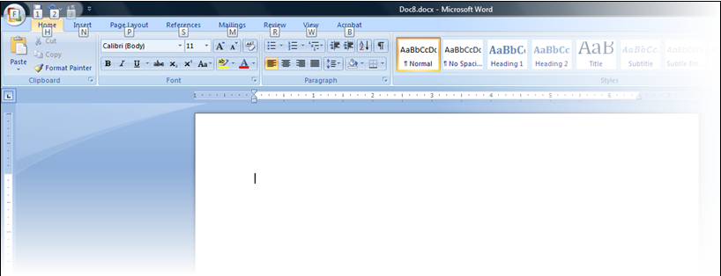
Press Alt key to see shortcuts

Slide 4
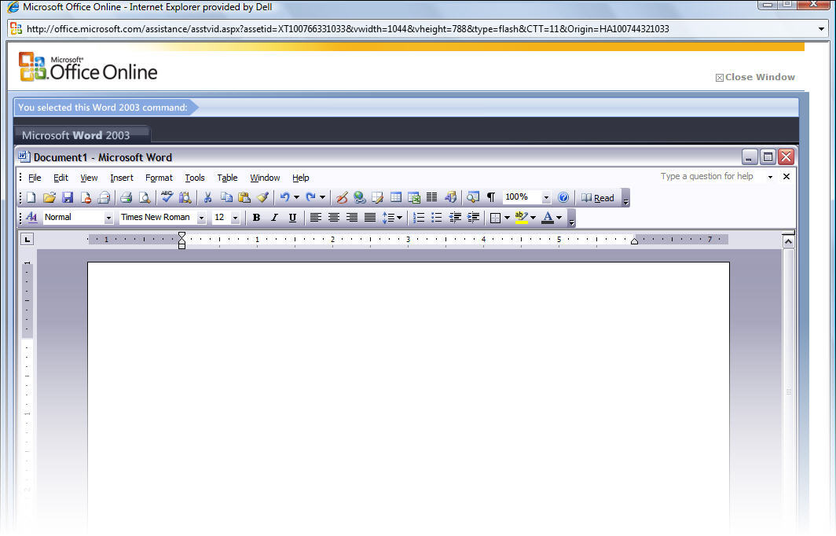
Word 2003 to Word 2007
Command Reference Guide
http://office.microsoft.com/en-us/word/HA100744321033.aspx

Slide 5
Open XML file formatting
.docx
Smaller file size
Improved recovery of damaged files
File format is open and available for other vendors to use when creating translators.
Supposed to be backwards compatible with other versions of Office

Slide 6
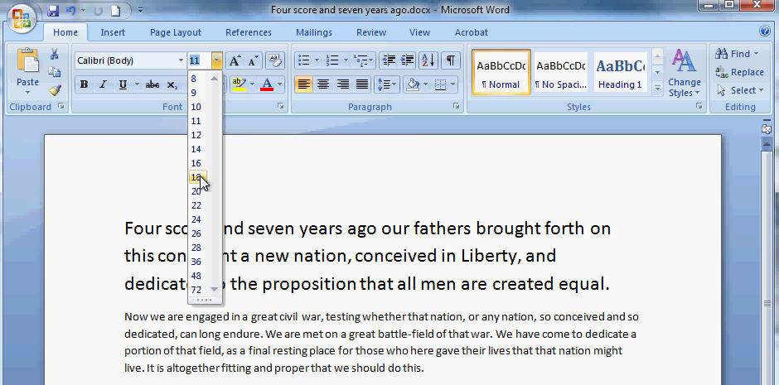
Live Previews
Quickly see formatting changes before you apply them
Can be confusing if you aren’t aware of this feature

Slide 7

What happened to Times New Roman?
Use Word 2003 styles in Word 2007
Add these steps to make 2003 a default
Click the Microsoft Office Button , and then click New.
Double-click on Blank document to create a new document.
On the Home tab, locate the Styles group, and then click Change Styles.
Then go to Style Set.
Click on Word 2003 Quick Style set.
The gallery of Quick Styles will change to reflect the new Quick Style set.
If you want to use Word 2003 font, then on the Home tab, in the Styles group, click Change Styles.
Then point to Fonts.
Click on Office Classic.
On the Home tab, locate the Styles group, then click Change Styles.
Then click Set as Default.
Source: http://www.mydigitallife.info/2006/12/11/switch-and-change-back-to-office-2003-default-font-and-style-set-in-office-word-2007/

Slide 8

SmartArt
Improve the visual look of bulleted lists and tables
On the Insert tab, in the Illustrations group, click SmartArt.
In the Choose a SmartArt Graphic dialog box, click the type and layout that you want.
Enter your text by doing one of the following:
  Click in a shape in your SmartArt graphic, and then type your text.
  Click [Text] in the Text pane, and then type or paste your text.
  Copy text from another program, click [Text], and then paste into the Text pane.

Slide 9
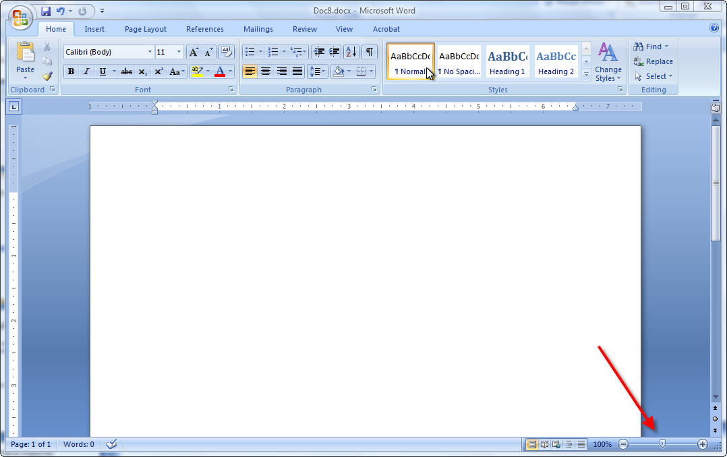
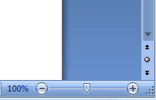
Slider bar for zooming in and out

Slide 10
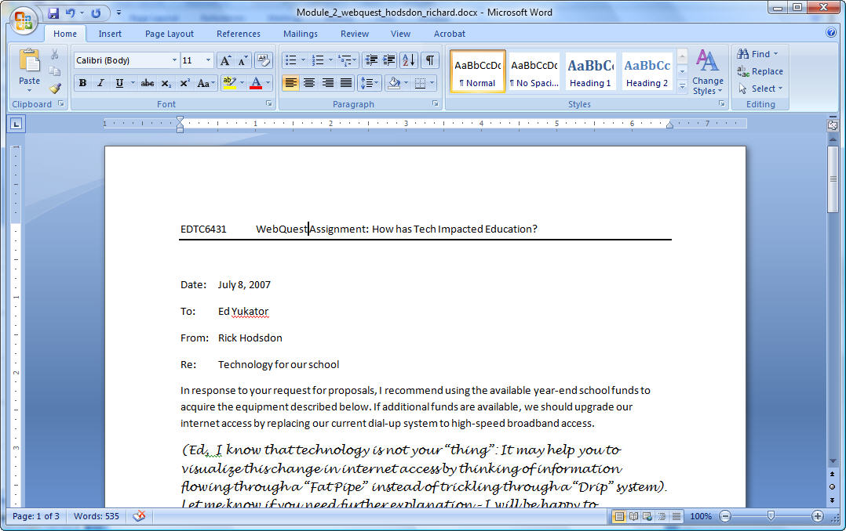
Word count
Always available
Lower left-hand corner

Slide 11
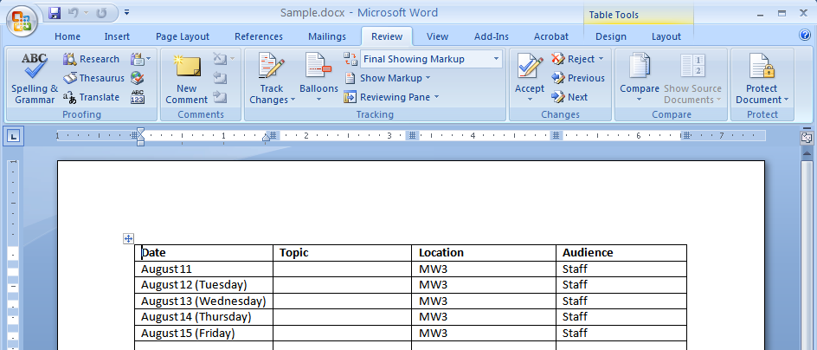
Reviewing Documents
Tracking changes
Adding comments
Accepting or rejecting changes

Slide 12
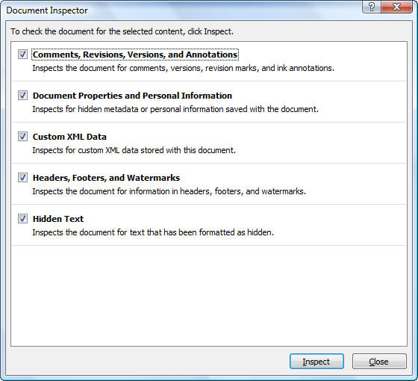
Document Inspector
Used to clean up document before making it public
Open the document you want to inspect for tracked changes and comments.
Click the Microsoft Office Button , point to Prepare, and then click Inspect Document.
In the Document Inspector dialog box, click Inspect.
Review the inspection results. If Document Inspector finds comments and tracked changes, you are prompted to click Remove All next to Comments, Revisions, Versions, and Annotations.
Click Reinspect or Close.

Slide 13
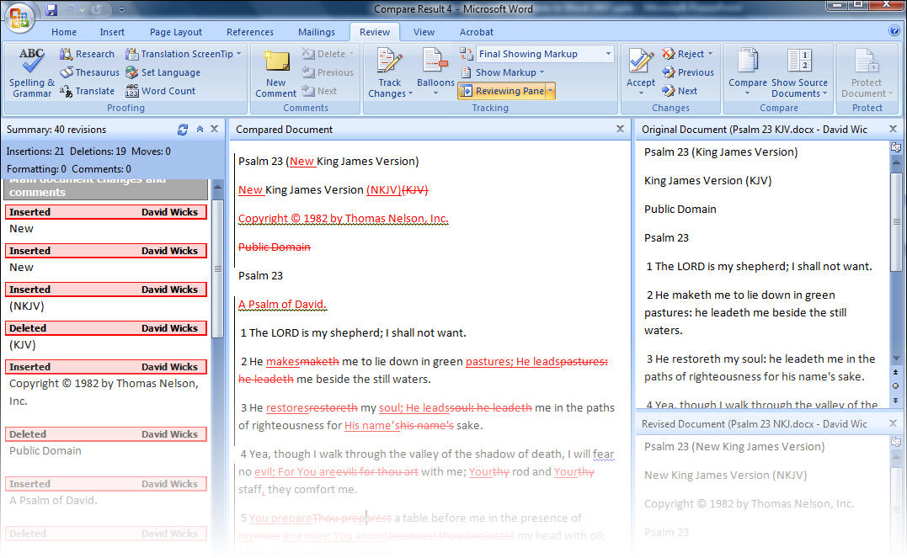
Compare two versions of same document
Review > Compare > Compare two versions
Look at two versions of same document side
by side
Merge changes from several authors into
one file

Slide 14
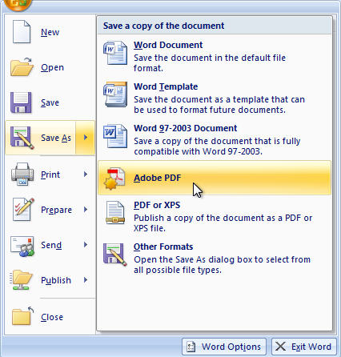
Save as PDF

Slide 15
Questions and Comments?

